Slide 1
PARALLEL AND DISTRIBUTED ALGORITHMS

Slide 2
Classically, algorithm designers assume a computer with only one processing element; the algorithms they design are said to be sequential, since the algorithms' steps must be performed in a particular sequence, one after another. But today's computers often have multiple processors, each of which performs its own sequence of steps.

Slide 3
Parallel Algorithm
A parallel algorithm is an algorithm that can execute several instructions simultaneously on different processing devices and then combine all the individual outputs to produce the final result.
Parallelism is the process of processing several set of instructions simultaneously. It reduces the total computational time. Parallelism can be implemented by using parallel computers.

Slide 4
Parallel computing
In a parallel computer, the processors are closely connected. Frequently, all processors share the same memory, and the processors communicate by accessing this shared memory. Examples of parallel computers include the multicore processors found in many computers today as well as many graphics processing units (GPUs).

Slide 5
Model of Computation
Both sequential and parallel computers operate on a set (stream) of instructions called algorithms. These set of instructions (algorithm) instruct the computer about what it has to do in each step.
Depending on the instruction stream and data stream, computers can be classified into four categories
•Single Instruction stream, Single Data stream (SISD) computers
•Single Instruction stream, Multiple Data stream (SIMD) computers
•Multiple Instruction stream, Single Data stream (MISD) computers
•Multiple Instruction stream, Multiple Data stream (MIMD) computers

Slide 6

SISD Computers
SISD computers contain one control unit, one processing unit, and one memory unit.
In this type of computers, the processor receives a single stream of instructions from the control unit and operates on a single stream of data from the memory unit. During computation, at each step, the processor receives one instruction from the control unit and operates on a single data received from the memory unit.

Slide 7
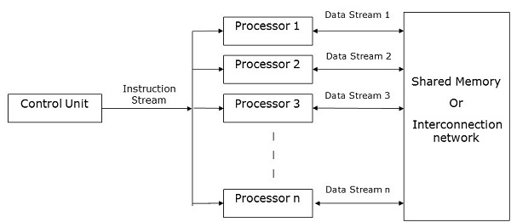
SIMD Computers
SIMD computers contain one control unit, multiple processing units, and shared memory or interconnection network.Here, each processor has its own control unit, local memory unit, and arithmetic and logic unit. They receive different sets of instructions from their respective control units and operate on different sets of data.

Slide 8
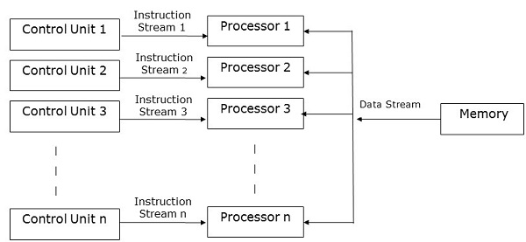
MISD Computers
As the name suggests, MISD computers contain multiple control units, multiple processing units, and one common memory unit.
Here, each processor has its own control unit and they share a common memory unit. All the processors get instructions individually from their own control unit and they operate on a single stream of data as per the instructions they have received from their respective control units. This processor operates simultaneously.

Slide 9
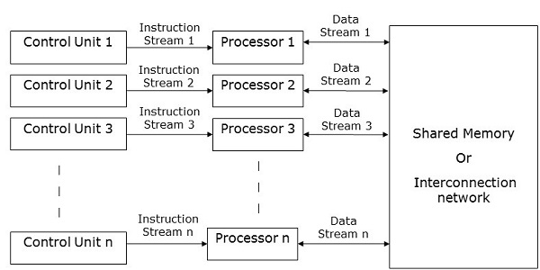
MIMD Computers
MIMD computers have multiple control units, multiple processing units, and a shared memory or interconnection network.
Here, each processor has its own control unit, local memory unit, and arithmetic and logic unit. They receive different sets of instructions from their respective control units and operate on different sets of data.

Slide 10

SIMD Computers
SIMD computers contain one control unit, multiple processing units, and shared memory or interconnection network.
Here, one single control unit sends instructions to all processing units. During computation, at each step, all the processors receive a single set of instructions from the control unit and operate on different set of data from the memory unit.
Each of the processing units has its own local memory unit to store both data and instructions. In SIMD computers, processors need to communicate among themselves. This is done by shared memory or by interconnection network.
While some of the processors execute a set of instructions, the remaining processors wait for their next set of instructions. Instructions from the control unit decides which processor will be active (execute instructions) or inactive (wait for next instruction).

Slide 11
Parallel Algorithm-model
The model of a parallel algorithm is developed by considering a strategy for dividing the data and processing method and applying a suitable strategy to reduce interactions. In this chapter, we will discuss the following Parallel Algorithm Models −
•Data parallel model
•Task graph model
•Work pool model
•Master slave model
•Producer consumer or pipeline model
•Hybrid model

Slide 12
Data Parallel
In data parallel model, tasks are assigned to processes and each task performs similar types of operations on different data. Data parallelism is a consequence of single operations that is being applied on multiple data items.
Data-parallel model can be applied on shared-address spaces and message-passing paradigms. In data-parallel model, interaction overheads can be reduced by selecting a locality preserving decomposition, by using optimized collective interaction routines, or by overlapping computation and interaction.
The primary characteristic of data-parallel model problems is that the intensity of data parallelism increases with the size of the problem, which in turn makes it possible to use more processes to solve larger problems.

Slide 13
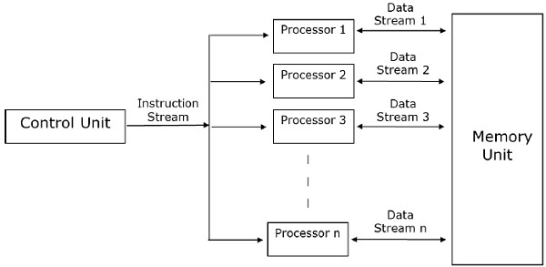

Slide 14
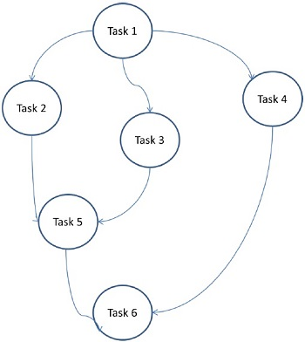
Task Graph Model
In the task graph model, parallelism is expressed by a task graph. A task graph can be either trivial or nontrivial. In this model, the correlation among the tasks are utilized to promote locality or to minimize interaction costs. This model is enforced to solve problems in which the quantity of data associated with the tasks is huge compared to the number of computation associated with them. The tasks are assigned to help improve the cost of data movement among the tasks.

Slide 15
Work Pool Model
In work pool model, tasks are dynamically assigned to the processes for balancing the load. Therefore, any process may potentially execute any task. This model is used when the quantity of data associated with tasks is comparatively smaller than the computation associated with the tasks.
There is no desired pre-assigning of tasks onto the processes. Assigning of tasks is centralized or decentralized. Pointers to the tasks are saved in a physically shared list, in a priority queue, or in a hash table or tree, or they could be saved in a physically distributed data structure.
The task may be available in the beginning, or may be generated dynamically. If the task is generated dynamically and a decentralized assigning of task is done, then a termination detection algorithm is required so that all the processes can actually detect the completion of the entire program and stop looking for more tasks.

Slide 16
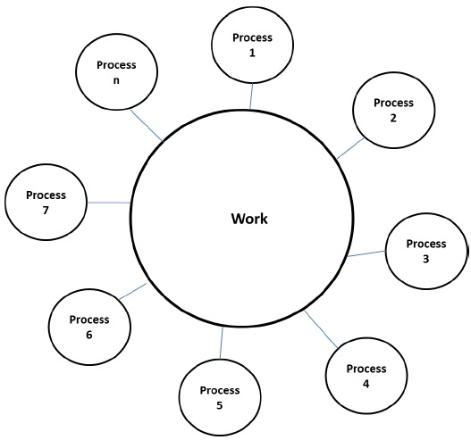

Slide 17
Master-Slave Model
In the master-slave model, one or more master processes generate task and allocate it to slave processes. The tasks may be allocated beforehand if −
the master can estimate the volume of the tasks, or
a random assigning can do a satisfactory job of balancing load, or
slaves are assigned smaller pieces of task at different times.
This model is generally equally suitable to shared-address-space or message-passing paradigms, since the interaction is naturally two ways.
In some cases, a task may need to be completed in phases, and the task in each phase must be completed before the task in the next phases can be generated. The master-slave model can be generalized to hierarchical or multi-level master-slave model in which the top level master feeds the large portion of tasks to the second-level master, who further subdivides the tasks among its own slaves and may perform a part of the task itself.

Slide 18
Precautions in using the master-slave model
Care should be taken to assure that the master does not become a congestion point. It may happen if the tasks are too small or the workers are comparatively fast.
The tasks should be selected in a way that the cost of performing a task dominates the cost of communication and the cost of synchronization.
Asynchronous interaction may help overlap interaction and the computation associated with work generation by the master.

Slide 19
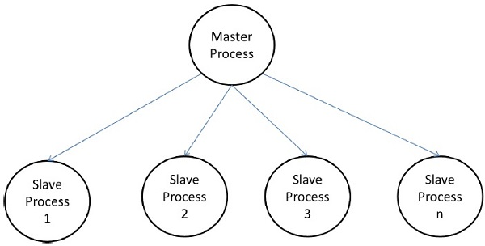

Slide 20
Pipeline Model
It is also known as the producer-consumer model. Here a set of data is passed on through a series of processes, each of which performs some task on it. Here, the arrival of new data generates the execution of a new task by a process in the queue. The processes could form a queue in the shape of linear or multidimensional arrays, trees, or general graphs with or without cycles.
This model is a chain of producers and consumers. Each process in the queue can be considered as a consumer of a sequence of data items for the process preceding it in the queue and as a producer of data for the process following it in the queue. The queue does not need to be a linear chain; it can be a directed graph. The most common interaction minimization technique applicable to this model is overlapping interaction with computation.

Slide 21
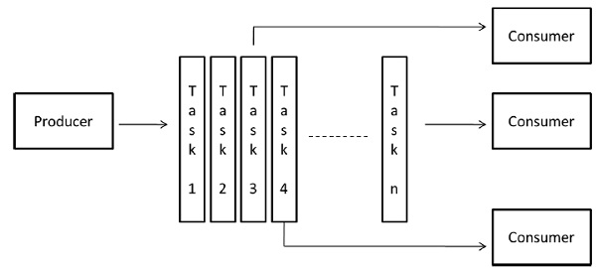

Slide 22
Hybrid Models
It is also known as the producer-consumer model. Here a set of data is passed on through a series of processes, each of which performs some task on it. Here, the arrival of new data generates the execution of a new task by a process in the queue. The processes could form a queue in the shape of linear or multidimensional arrays, trees, or general graphs with or without cycles.

Slide 23
DISTRIBUTED
A distributed algorithm is one that is divided in several processors, so that some part of the algorithm is run on one processor, other part in another processor, and so forth.
Typically data is partitioned in advance so that each processor doesn't need to wait for the output of another processor, but that is not always feasable, and their is some form of communication between processors.
Now something important: If the processors share memory (RAM), it means they run on the same machine and it is called parallel algorithm. If they run on different boxes, it means they need a communication medium like a network cable and they are called distrobuted algorithms.

Slide 24
Why make that distinction?
CPU registers are really fast, because you can access them inside the CPU. Typically in one CPU cycle you can read or write a CPU register.
Then there is a L1 cache and an L2 cache. Those are slower.
Then RAM takes at least 10 CPU cycles, sometimes 100, depending on the speed of the RAM, the speed of the CPU and the protocol, collisions on the data bus, etc. Not easy to find out.
There is also address translation, which adds some cost, but not so much because of the MMU chip.
Also what happens if two processes try to access the same memory location and leve it inconsitent? You need synchroniztion, that is what the synchronized Java keyword is for.
And that is only for parallel algorithms.

Slide 25
Distributed computing
A distributed system is one in which the processors are less strongly connected. A typical distributed system consists of many independent computers in the same room, attached via network connections. Such an arrangement is often called a cluster.
In a distributed system, each processor has its own independent memory. This precludes using shared memory for communicating. Processors instead communicate by sending messages. In a cluster, these messages are sent via the network. Though message passing is much slower than shared memory, it scales better for many processors, and it is cheaper. Plus programming such a system is arguably easier than programming for a shared-memory system, since the synchronization involved in waiting to receive a message is more intuitive. Thus, most large systems today use message passing for interprocessor communication.
From now on, we'll be working with a message-passing system implemented using the following two functions.

Slide 26
A distributed algorithm is an algorithm, run on a distributed system, that does not assume the previous existence of a central coordinator.
A distributed system is a collection of processors that do not share memory or a clock. Each processor has its own memory, and the processors communicate via communication networks.
We will consider two problems requiring distributed algorithms, the coordinator election problem and the value agreement problem (Byzantine generals problem)

